Slide 1



Living HTA
Automating HTA with R
Monday 23rd May 2022 | R-HTA Workshop, Oxford UK
Robert Smith^{1,2,3}, Paul Schneider^{2,3} & Wael Mohammed^{2,3}
^{1 Lumanity, Sheffield}
2 Dark Peak Analytics, Sheffield
3 ScHARR, University of Sheffield

Slide 2
Living HTA: Automating HTA with R
Robert Smith ^{1,2,3} & Paul Schneider ^{2,3} & Wael Mohammed ^{2,3}
¹ Lumanity, Sheffield, ² ScHARR, University of Sheffield, ³ Dark Peak Analytics, Sheffield
Background The process of updating economic models is time-consuming and expensive, and often involves the transfer of sensitive data between parties. Here, we demonstrate how HEOR can be conducted in a way that allows companies to retain full control of their data, while automating reporting as new information becomes available.
Method We developed an automated analysis and reporting pipeline for health economic modelling and made the source code openly available on a GitHub repository. It consists of three parts:
• An economic model is constructed by the consultant using pseudo data (i.e. random data, which has the same format as the real data).
• On the company side, an application programming interface (API), generated using the R package plumber, is hosted on a server. An automated workflow is created. This workflow sends the economic model to the company API. The model is then run within the company server. The results are sent back to the consultant, and a (PDF) report is automatically generated using RMarkdown.
• This API hosts all sensitive data, so that data does not have to be provided to the consultant.
Results & Discussion The method is relatively complex, and requires a strong understanding of R, APIs, RMarkdown and GitHub Actions. However, the result is a process, which allows the consultant to conduct health economic (or any other) analyses on company data, without having direct access – the company does not need to share their sensitive data. The workflow can be scheduled to run at defined time points (e.g. monthly), or when triggered by an event (e.g. an update to the underlying data or model code). Results are generated automatically and wrapped into a full report. Documents no longer need to be revised manually.
Conclusions This example demonstrates that it is possible, within a HEOR setting, to separate the health economic model from the data, and automate the main steps of the analysis pipeline. We believe this is the first application of this procedure for a HEOR project.
Abstract for R-HTA Workshop - Thursday 19th, Friday 20th, and Monday 23rd May 2022 – Oxford, UK.

Slide 3
Agenda
Section | Title | Page
1 | Background | 4
2 | Concept | 6
3 | Hosting a HE model in an API | 9
4 | Calling the API from R | 11
5 | Automating health economic model updates | 13
6 | Discussion | 15

Slide 4


Background
1.
What problems exist?

Slide 5
Background
There are several changes occurring simultaneously in health economics & decision science.
New technologies - shift to open-source packages (e.g. Rmarkdown, Shiny, BCEA, Heemod).
Previous presentations on Shiny to make R more accessible, but why R? Why not Python. APIs help mitigate this.
Big data - Increased use of large datasets, and concerns around data-security.
We will show a method of allowing companies to retain control of their data.
Big simulation – incorporating uncertainty in health economic models.
By running models on remote servers, we can easily scale up computing power.
Shift from recommendations from ‘static’ to ‘dynamic’ (Living)
“The ability to link real-world evidence with evidence-based practice will drive a shift from recommendations being produced at a single ‘static’ point in time to more dynamic, living guidance, and from health technology assessment to health technology management.” NICE strategy 2021 to 2026: Dynamic, Collaborative, Excellent

Slide 6
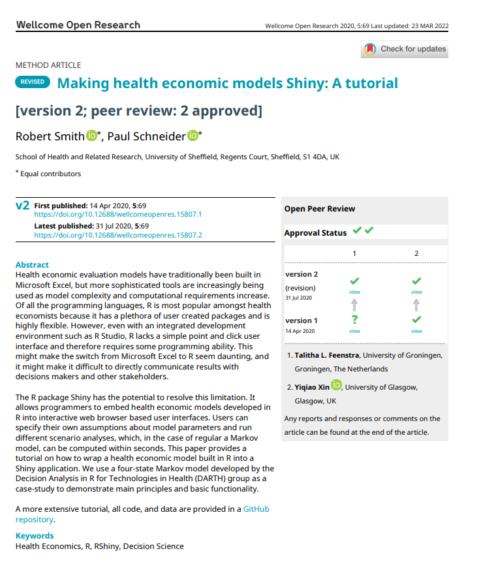
Background … continued
Making Health Economics Shiny
Our previous tutorial paper showed how to take a model in R and host it in an R-Shiny application.
This helps to make models in R more usable by humans.
However, this often requires data to be shared with a consultant.
Also requires a lot of human interaction, for example would need to be updated if data is updated.
Our focus now turns to developing a framework where data doesn’t need to be shared, and model reports/applications can be ‘living’ to reflect the latest data.

Slide 7
Concept
2.
How to implement this …

Slide 8




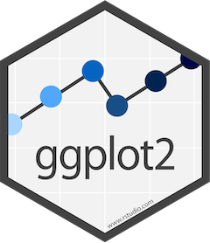

What we will show today …
Using open-source software to generate an automated HTA workflow…
Construct a script-based health economic models in R. Although could be Python, Ruby, Julia ….
Host health economic model on GitHub repository, provide access to company.
Host API on company server. The API will:
… have access to sensitive data.
… enable users to run R code on it.
… allow users to pass R code to it.
… return model results from it.
Write script to pass model inputs & code to company API & generate a PDF report using markdown.
Create a workflow which runs the script on schedule, or as new evidence emerges (e.g. when a data-base is updated).
Contain all this functionality within a Shiny app – to enable non-programmers to interact with the API.

Slide 9
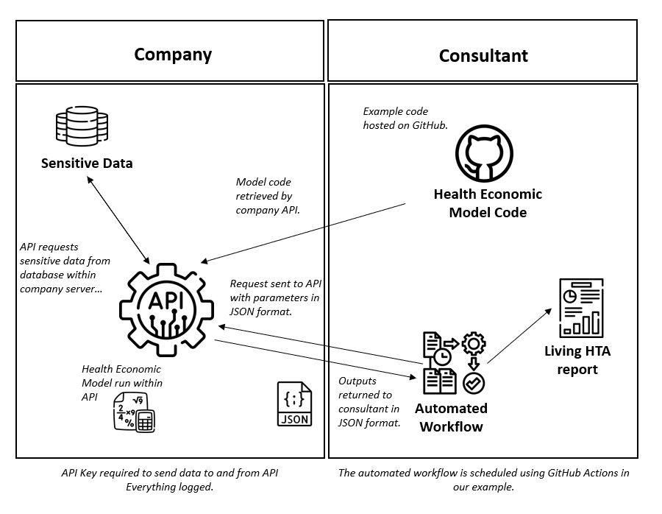
Living HEOR: Automating HTA with R

Slide 10
Hosting a HE model in an API
3.
Creating an Application Programming Interface to host a health economic model using the plumber R package.

Slide 11
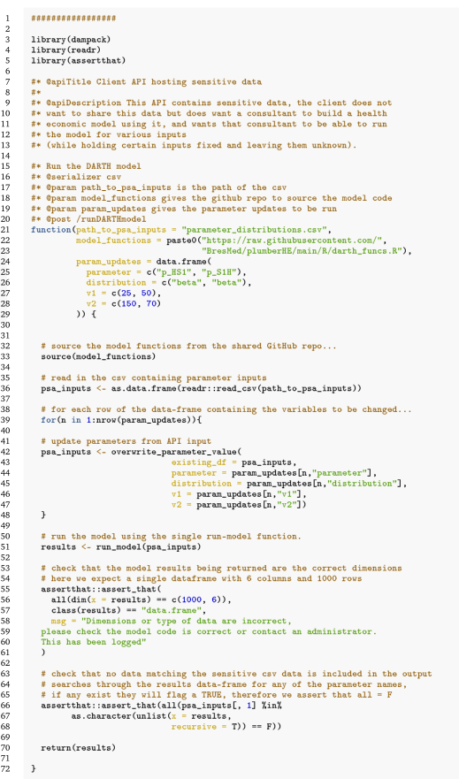
Hosting a HE model in an API
Load necessary packages
Describe the API, used in Swagger
Roxygen style documentation for function, what are the inputs…
Source the model functions from GitHub
Overwrite default data with non-sensitive inputs
Run the model
Check the results object doesn’t contain sensitive data
Return the results object

Slide 12
Calling the API from R
4.
Passing parameters and code to the health economic model & returning results…

Slide 13
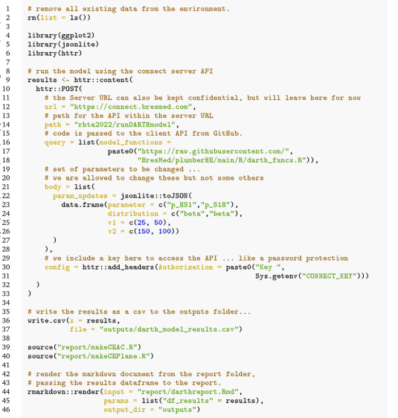
Running the model – calling the API
Load necessary packages
Call the API:
URL and path combine to identify where the API is.
Query and body both allow for inputs to be provided to the API… We convert the data-frame of inputs to JSON first.
Config allows us to add the KEY – which is hidden as an environment variable.
Result of the API is stored as an object (results).
Write the results to a csv… not strictly necessary.
Render an Rmarkdown document based on the results of the API call, store the document in ‘outputs’ directory.

Slide 14
Automating health economic model updates
5.
Automating health economic model updates using GitHub Actions and R-markdown.

Slide 15
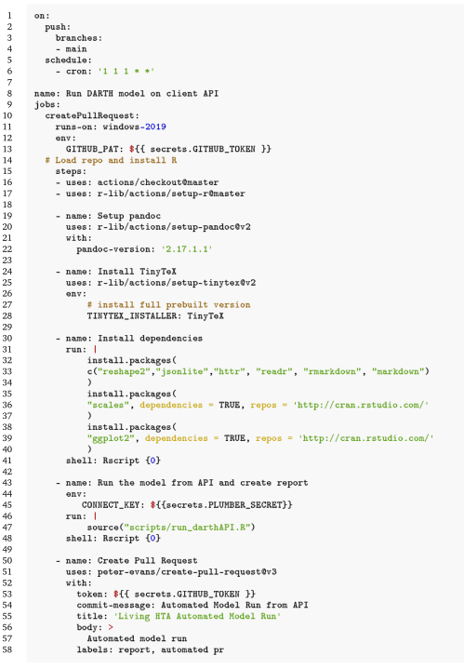
Automating health economic model updates
Schedule jobs based upon a push to the main branch, or at a scheduled time (00:01 on 1st of the month).
Set-up code:
Start running a Windows 2019 server.
Checkout the repository.
Set up R.
Install all dependencies
Run the script querying the API and creating a report with Rmarkdown.
Create a pull request to the repository with the new results csv and markdown report included.

Slide 16
Discussion
6.
What are the implications of these methods…

Slide 17
What are the pros and cons of this framework.
Advantages of this framework
Security - Data owners retain control of their data. No data need leave the data-owner’s servers.
Transparency - Separating the model code from the data can significantly improve the transparency of the health economic model. Many models could be passed to the data, not just one!
Computational Power - The computational burden of the model is handled on a remote server.
Storage – Larger datasets can be analyzed than would be possible on a laptop.
Living analysis - API calls can be made at any time. A decision maker can see a report that will always reflect the data held by the company.
Disadvantages of this framework
Security - Likely to remain concerns about data security, even with the authentication procedures built into the API functionality.
Transparency - Risk that running the model remotely will result in the perception that the model is a ‘black box’ (I’d disagree!).
Coding practice - The model code needs to be versatile enough to manage unknown data updates. Proper testing will help mitigate these risks.
Technical skillset - This is not commonly implemented, or a common skill-set among health economists. Most models are not built in R.
What are the needs of different stakeholders? The company, the consultant, the HTA body, the ERG?
When is this likely to be most useful?
Is this too big a leap – can we pull HEOR this far?

Slide 18
Thank you
More information about this presentation can be found at:
Open-source code: RobertASmithBresMed/plumberHE: Health Economics using Plumber APIs (github.com)
Draft paper: plumberHE/academicpaper.pdf at main · RobertASmithBresMed/plumberHE (github.com)
More information about the author’s organizations can be found at:
Lumanity
Dark Peak Analytics
ScHARR, University of Sheffield

